Slide 1
TRANSISTOR
BIASING
1

Slide 2
Transistor Biasing
The basic function of transistor is amplification. The process of raising the strength of weak signal without any change in its general shape is referred as faithful amplification. For faithful amplification it is essential that:-
Emitter-Base junction is forward biased
Collector- Base junction is reversed biased
Proper zero signal collector current
The proper flow of zero signal collector current and the maintenance of proper collector emitter voltage during the passage of signal is called transistor biasing.

Slide 3
WHY BIASING?
If the transistor is not biased properly, it would work inefficiently and produce distortion in output signal.
HOW A TRANSISTOR CAN BE BIASED?
A transistor is biased either with the help of battery or associating a circuit with the transistor. The later method is more efficient and is frequently used. The circuit used for transistor biasing is called the biasing circuit.

Slide 4
BIAS STABILITY
Through proper biasing, a desired quiescent operating point of the transistor amplifier in the active region (linear region) of the characteristics is obtained. It is desired that once selected the operating point should remain stable. The maintenance of operating point stable is called Stabilisation.
The selection of a proper quiescent point generally depends on the following factors:
  The amplitude of the signal to be handled by the amplifier and distortion level in signal
  The load to which the amplifier is to work for a corresponding supply voltage
The operating point of a transistor amplifier shifts mainly with changes in temperature, since the transistor parameters — β, I_{CO} and V_{BE} (where the symbols carry their usual meaning)—are functions of temperature.

Slide 5
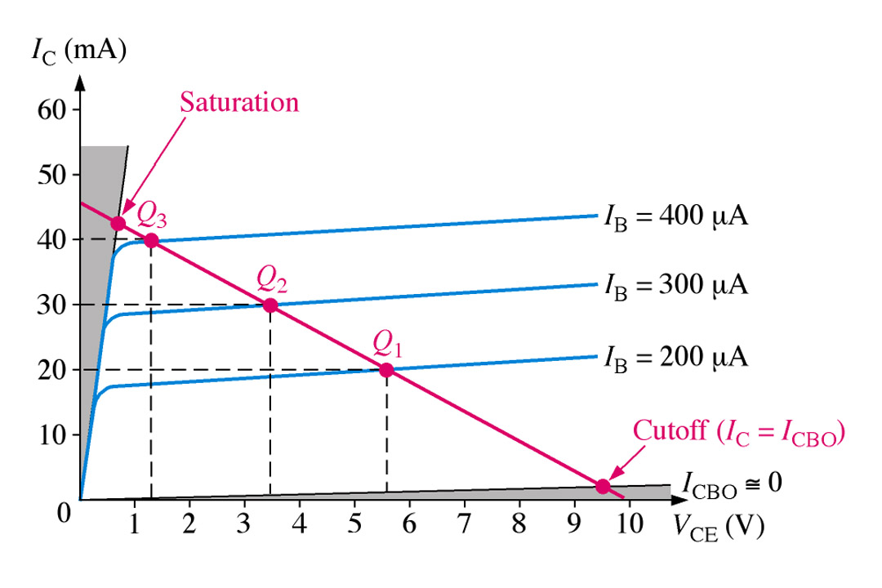
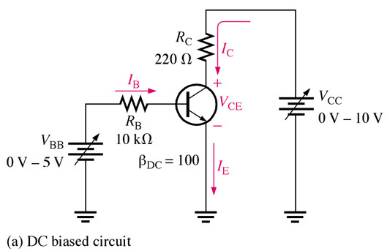
The DC Operating Point
For a transistor circuit to amplify it must be properly biased with dc voltages. The dc operating point between saturation and cutoff is called the Q-point. The goal is to set the Q-point such that that it does not go into saturation or cutoff when an a ac signal is applied.

Slide 6
Requirements of biasing network
Ensuring proper zero signal collector current.
Ensuring VcE not falling below 0.5V for Ge transistor and 1V for Silicon transistor at any instant.
Ensuring Stabilization of operating point. (zero signal IC and VcE)

Slide 7
The Thermal Stability of Operating Point (S_{Ico )}
Stability Factor S:- The stability factor S, as the change of collector current with respect to the reverse saturation current, keeping β and VBE constant. This can be written as:
The Thermal Stability Factor : S_{Ico}
S_{Ico} = ∂I_{c}
∂I_{co}
This equation signifies that I_{c} Changes S_{Ico} times as fast as I_{co}
Differentiating the equation of Collector Current I_{C} = (1+β)Ico+ βIb & rearranging the terms we can write
S_{Ico} ═ 1+β
1- β (∂I_{b}/∂I_{C})
It may be noted that Lower is the value of S_{Ico} better is the stability
V_{be}, β

Slide 8
Various Biasing Circuits
Fixed Bias Circuit
Fixed Bias with Emitter Resistor
Collector to Base Bias Circuit
Potential Divider Bias Circuit

Slide 9
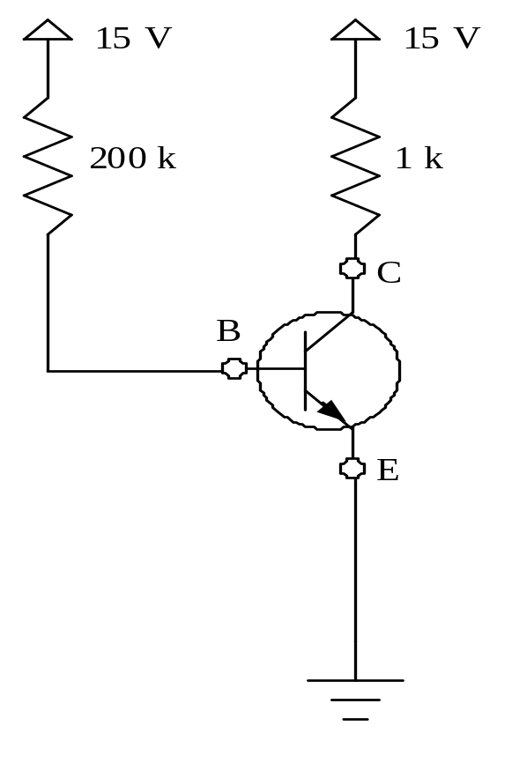
1. The Fixed Bias Circuit
The Thermal Stability Factor : S_{Ico}
S_{Ico} = ∂I_{c}
∂I_{co}
General Equation of S_{Ico} Comes out to be
S_{Ico} ═ 1 + β
1- β (∂I_{b}/∂I_{C})
V_{be}, β
R_{C}
R_{b}
R_{C}
Applying KVL through Base Circuit we can write, I_{b} R_{b}+ V_{be}= V_{cc}
Diff w. r. t. I_{C}, we get (∂I_{b} / ∂I_{c}) = 0
S_{Ico}= (1+β) is very large
Indicating high un-stability
I_{b}

Slide 10
Merits:
It is simple to shift the operating point anywhere in the active region by merely changing the base resistor (RB).
A very small number of components are required.
Demerits:
The collector current does not remain constant with variation in temperature or power supply voltage. Therefore the operating point is unstable.
When the transistor is replaced with another one, considerable change in the value of β can be expected. Due to this change the operating point will shift.
For small-signal transistors (e.g., not power transistors) with relatively high values of β (i.e., between 100 and 200), this configuration will be prone to thermal runaway. In particular, the stability factor, which is a measure of the change in collector current with changes in reverse saturation current, is approximately β+1. To ensure absolute stability of the amplifier, a stability factor of less than 25 is preferred, and so small-signal transistors have large stability factors.

Slide 11
Usage:
Due to the above inherent drawbacks, fixed bias is rarely used in linear circuits (i.e., those circuits which use the transistor as a current source). Instead, it is often used in circuits where transistor is used as a switch. However, one application of fixed bias is to achieve crude automatic gain control in the transistor by feeding the base resistor from a DC signal derived from the AC output of a later stage.

Slide 12
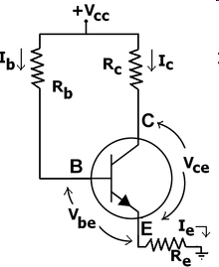
2. Fixed bias with emitter resistor
The fixed bias circuit is modified by attaching an external resistor to the emitter. This resistor introduces negative feedback that stabilizes the Q-point.

Slide 13
Merits:
The circuit has the tendency to stabilize operating point against changes in temperature and β-value.
Demerits:
As β-value is fixed for a given transistor, this relation can be satisfied either by keeping RE very large, or making RB very low.
If RE is of large value, high VCC is necessary. This increases cost
as well as precautions necessary while handling.
      If RB is low, a separate low voltage supply should be used in the base circuit. Using two supplies of different voltages is impractical.
In addition to the above, RE causes ac feedback which reduces the voltage gain of the amplifier.
Usage:
The feedback also increases the input impedance of the amplifier when seen from the base, which can be advantageous. Due to the above disadvantages, this type of biasing circuit is used only with careful consideration of the trade-offs involved.

Slide 14
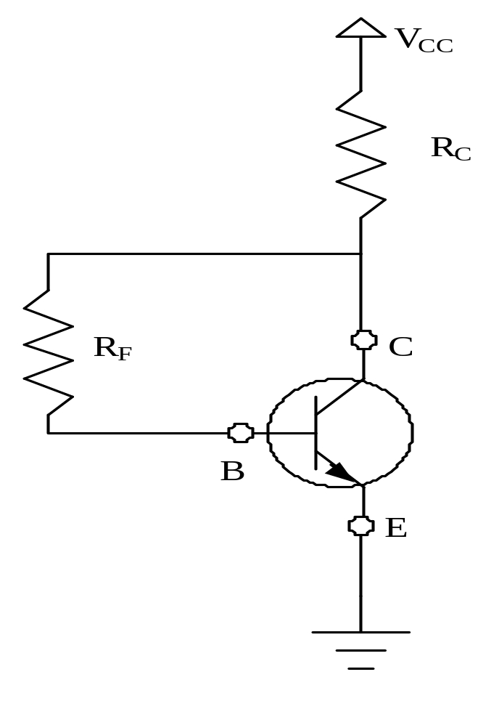
3. The Collector to Base Bias Circuit
This configuration employs negative feedback to prevent thermal runaway and stabilize the operating point. In this form of biasing, the base resistor RF is connected to the collector instead of connecting it to the DC source Vcc. So any thermal runaway will induce a voltage drop across the Rc resistor that will throttle the transistor's base current.
I_{c}
I_{b}
+
V_{BE}
-
I_{E}

Slide 15
Applying KVL through base circuit
we can write (I_{b}+ I_{C}) R_{C} + I_{b} R_{f}+ V_{be}= V_{cc}
Diff. w. r. t. I_{C} we get
(∂I_{b} / ∂I_{c}) = - R_{C} / (R_{f} + R_{C})
Therefore, S_{Ico} ═ (1+ β)
1+ [βR_{C}/(R_{C}+ R_{f})]
Which is less than (1+β), signifying better thermal stability

Slide 16
Merits:
Circuit stabilizes the operating point against variations in temperature
and β (i.e. replacement of transistor)
Demerits:
As β -value is fixed (and generally unknown) for a given transistor, this relation can be satisfied either by keeping Rc fairly large or making Rf very low.
      If Rc is large, a high Vcc is necessary, which increases cost as well as
      precautions necessary while handling.
      If Rf is low, the reverse bias of the collector–base region is small, which limits the range of collector voltage swing that leaves the transistor in active mode.
      The resistor Rf causes an AC feedback, reducing the voltage gain of the amplifier. This undesirable effect is a trade-off for greater Q-point stability.
Usage: The feedback also decreases the input impedance of the amplifier as seen from the base, which can be advantageous. Due to the gain reduction from feedback, this biasing form is used only when the trade-off for stability is warranted.

Slide 17
4. The Potential Divider Bias Circuit
This is the most commonly used arrangement for biasing as it provide good bias stability.
In this arrangement the emitter resistance ‘RE’ provides stabilization. The resistance ‘RE’ cause a voltage drop in a direction so as to reverse bias the emitter junction.
Since the emitter-base junction is to be forward biased, the base voltage is obtained from R1-R2 network.
The net forward bias across the emitter base junction is equal to VB- dc voltage drop across ‘RE’.
The base voltage is set by Vcc and R1 and R2. The dc bias circuit is independent of transistor current gain. In case of amplifier, to avoid the loss of ac signal, a capacitor of large capacitance is connected across RE.
The capacitor offers a very small reactance to ac signal and so it passes through the condenser.

Slide 18
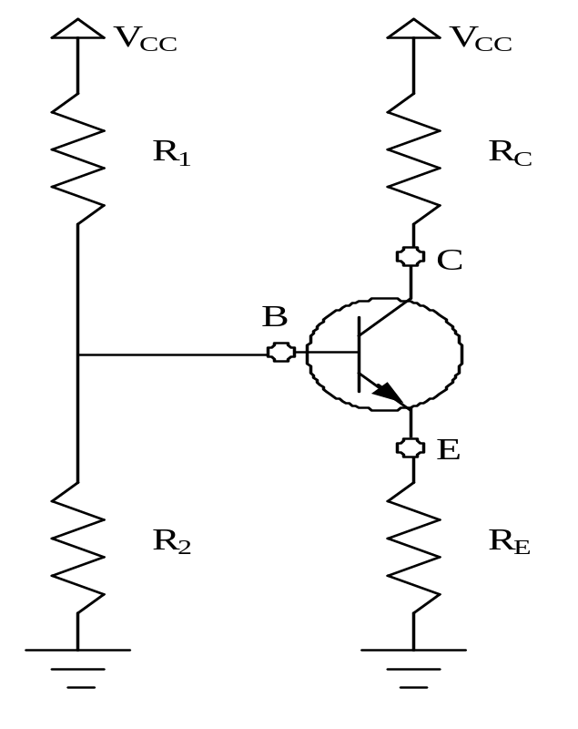
The Potential Divider Bias Circuit
To find the stability of this circuit we have to convert this circuit into its Thevenin’s Equivalent circuit
I_{C}
I_{b}
R_{th} ₌ R₁*R₂ & V_{th} ₌ Vcc R₂
R₁+R₂ R₁+R₂
R_{th} ₌ R₁*R₂ & V_{th} ₌ Vcc R₂
R₁+R₂ R₁+R₂
R_{th} ₌ R₁*R₂ & V_{th} ₌ Vcc R₂
R₁+R₂ R₁+R₂
R_{th} ₌ R₁*R₂ & V_{th} ₌ Vcc R₂
R₁+R₂ R₁+R₂
I_{E}

Slide 19
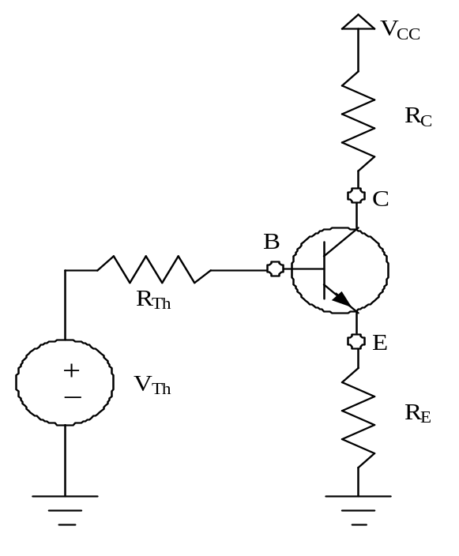
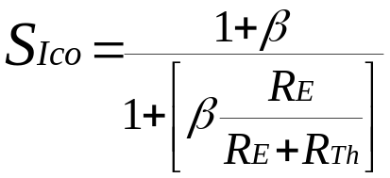
The Potential Divider Bias Circuit
Applying KVL through input base circuit
we can write I_{b}R_{Th} + I_{E} R_{E}+ V_{be}= V_{Th}
Therefore, I_{b}R_{Th} + (I_{C}+ I_{b}) R_{E}+ V_{BE}= V_{Th}
Diff. w. r. t. I_{C} & rearranging we get
(∂I_{b} / ∂I_{c}) = - R_{E} / (R_{Th} + R_{E})
Therefore,
This shows that S_{Ico} is inversely proportional to R_{E} and It is less than (1+β), signifying better thermal stability
Thevenin Equivalent Ckt
I_{C}
I_{b}
IE
Self-bias Resistor
Thevenin Equivalent Voltage

Slide 20
Merits:
Operating point is almost independent of β variation.
Operating point stabilized against shift in temperature.
Demerits:
As β-value is fixed for a given transistor, this relation can be satisfied either
by keeping RE fairly large, or making R1||R2 very low.
      If RE is of large value, high VCC is necessary. This increases cost as well
as precautions necessary while handling.
      If R1 || R2 is low, either R1 is low, or R2 is low, or both are low. A low R1 raises VB closer to VC, reducing the available swing in collector voltage, and limiting how large RC can be made without driving the transistor out of active mode. A low R2 lowers Vbe, reducing the allowed collector current. Lowering both resistor values draws more current from the power supply and lowers the input resistance of the amplifier as seen from the base.
      AC as well as DC feedback is caused by RE, which reduces the AC voltage gain of the amplifier. A method to avoid AC feedback while retaining DC feedback is discussed below.
Usage:
The circuit's stability and merits as above make it widely used for linear circuits.

Slide 21
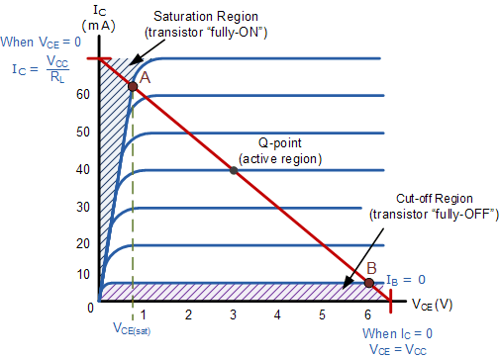
Transistor as a Switch
When used as an AC signal amplifier, the transistors Base biasing voltage is applied in such a way that it always operates within its “active” region, that is the linear part of the output characteristics curves are used. However, both the NPN & PNP type bipolar transistors can be made to operate as “ON/OFF” type solid state switches by biasing the transistors base differently to that of a signal amplifier.

Slide 22
The areas of operation for a Transistor Switch are known as the Saturation Region and the Cut-off Region.
This means then that we can ignore the operating Q-point biasing and voltage divider circuitry required for amplification, and use the transistor as a switch by driving it back and forth between its “fully-OFF” (cut-off) and “fully-ON” (saturation) regions as shown in figure.
The pink shaded area at the bottom of the curves represents the “Cut-off” region while the blue area to the left represents the “Saturation” region of the transistor. Both these transistor regions are defined as:

Slide 23
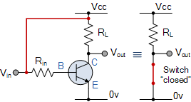
  Cut-off Region
Then we can define the “cut-off region” or “OFF mode” when using a bipolar transistor as a switch as being, both junctions reverse biased, VB < 0.7v and IC = 0. For a PNP transistor, the Emitter potential must be negative with respect to the Base.
Here the operating conditions of the transistor are zero input base current ( IB ), zero output collector current ( IC ) and maximum collector voltage ( VCE ) which results in a large depletion layer and no current
flowing through the device. Therefore the transistor is switched “Fully-
OFF”.
transistor switch in cut-off

Slide 24
2. Saturation Region
Here the transistor will be biased so that the maximum amount of base current is applied, resulting in maximum collector current resulting in the minimum collector emitter voltage drop which results in the depletion layer being as small as possible and maximum current flowing through the transistor. Therefore the transistor is switched “Fully-ON”.
transistor switch in saturation

Slide 25
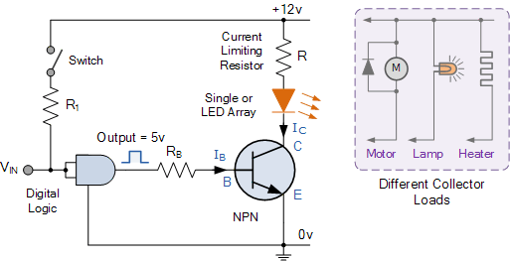
Digital Logic Transistor Switch

Slide 26

A Switch Example
Using the transistor values from the previous tutorials of: β = 200, Ic = 4mA and Ib = 20uA, find the value of the Base resistor (Rb) required to switch the load fully “ON” when the input terminal voltage exceeds 2.5v.
  Transistor Switch Base Resistance

Slide 27
Applications
Transistor switches can be used to switch and control l amps, relays or even motors.
When using the bipolar transistor as a switch they must be either “fully-OFF” or “fully-ON”.
Transistors that are fully “ON” are said to be in their Saturation region.
Transistors that are fully “OFF” are said to be in their Cut-off region.
When using the transistor as a switch, a small Base current controls a much
larger Collector load current
When using transistors to switch inductive loads such as relays and solenoids, a “Flywheel Diode” is used.
When large currents or voltages need to be controlled, Darlington
Transistors can be used

